Slide 1
深度学习：绪论
Notes:
Adept form {李宏毅 Hung-yi Lee} tutorial for fast “warm up”.

Slide 2
Outline
“Hello World” for Deep Learning
Introduction of Deep Learning
Tips for Deep Learning
Notes:
The three steps can also apply on other machine learning methods

Slide 3
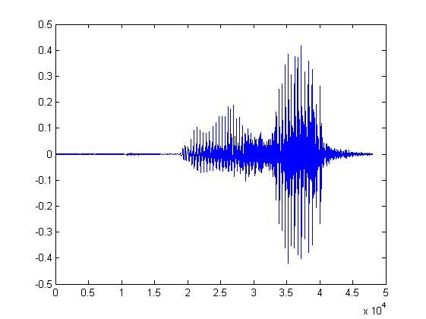

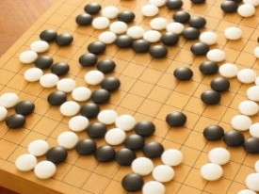
Machine Learning ≈ Looking for a Function
Speech Recognition
Image Recognition
Playing Go
Dialogue System
“How are you”
“Cat”
“5-5”
(next move)
“Hi”
“Hello”
(what the user said)
(system response)

Slide 4
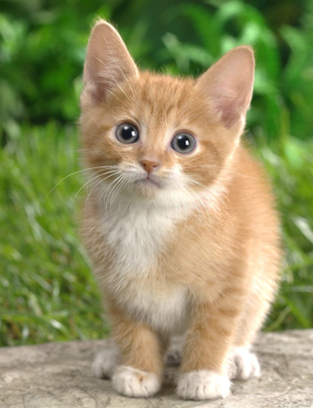

Framework
Image Recognition:
“cat”
A set of function
Model
“cat”
“monkey”
“dog”
“snake”
Notes:
Repeat again

Slide 5
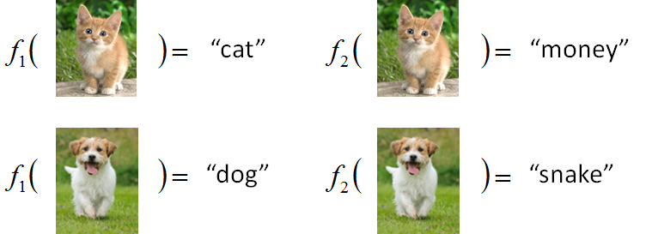

Framework
Image Recognition:
“cat”
A set of function
Model
Better!
Goodness of function f
Supervised Learning
Training
Data
function input:
function output:
“monkey”
“cat”
“dog”
Notes:
Repeat again

Slide 6
Framework
Image Recognition:
“cat”
A set of function
Model
Training
Testing
“cat”
Step 1
Goodness of function f
Pick the “Best” Function
Using
Step 2
Step 3
Training
Data
“monkey”
“cat”
“dog”
Notes:
Repeat again

Slide 7
Three Steps for Deep Learning
Step 1: define a set of function
Step 2: goodness of function
Step 3: pick the best function
Neural Network

Slide 8
Neural Network
Neuron
A simple function
…
…
…
…
Activation function
weights
bias
Notes:
sigmoid

Slide 9
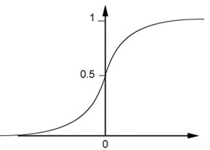
Neural Network
Neuron
Sigmoid Function
2
1
4
-1
-2
0.98
Activation function
-1
1
weights
1
bias
Notes:
sigmoid

Slide 10
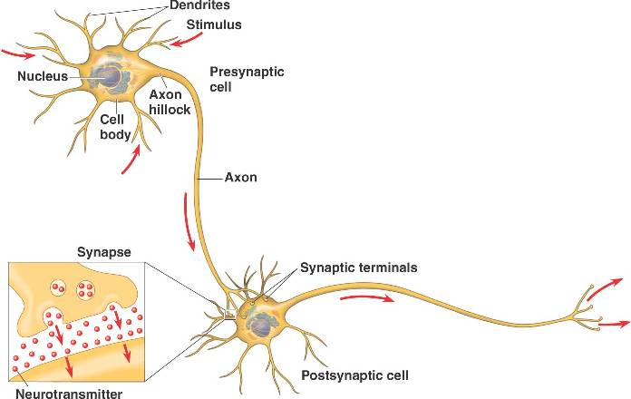
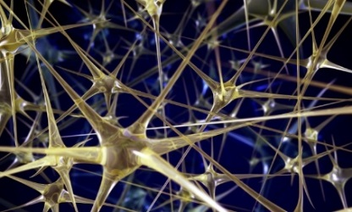

Neural Network
Different connections lead to different network structures
The neurons have different values of weights and biases.
Weights and biases are network parameters $θ$
Notes:
The values of weights and biases will be obtained by learning (step 3).

Slide 11
Fully Connect Feedforward Network
1
4
0.98
1
-2
1
-1
-2
0.12
-1
1
0
Sigmoid Function

Slide 12
Fully Connect Feedforward Network
1
4
0.98
2
0.86
3
0.62
1
-2
-1
-1
1
0
-2
-1
-2
0.12
-2
0.11
-1
0.83
-1
1
-1
4
0
0
2

Slide 13
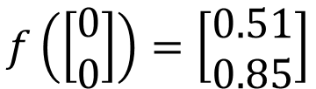
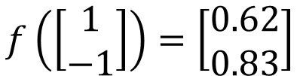

Fully Connect Feedforward Network
1
0.73
2
0.72
3
0.51
0
-2
-1
-1
1
0
-2
-1
0.5
-2
0.12
-1
0.85
0
1
-1
4
0
0
2
This is a function.
$$f\left(\left[\begin{matrix}1 \\ −1\end{matrix}\right]\right)=\left[\begin{matrix}0.62 \\ 0.83\end{matrix}\right]$$
$$f\left(\left[\begin{matrix}0 \\ 0\end{matrix}\right]\right)=\left[\begin{matrix}0.51 \\ 0.85\end{matrix}\right]$$
Input vector, output vector
Given parameters $θ$, define a function
Given network structure, define a function set
Notes:
For example, if we modify “1” to “2”, then we have another function

Slide 14
Fully Connect Feedforward Network
neuron
Input
Layer 1
Layer 2
Layer L
Output
……
y₁
……
y₂
……
……
……
……
……
……
y_{M}
Input Layer
Output Layer
Hidden Layers
Deep means many hidden layers

Slide 15
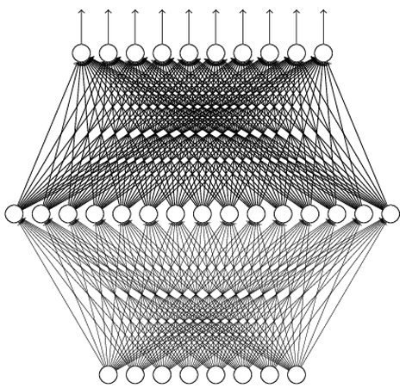
Why Deep? Universality Theorem
Any continuous function f
Can be realized by a network with one hidden layer
(given enough hidden neurons)
Reference for the reason: http://neuralnetworksanddeeplearning.com/chap4.html
通用函数近似定理：即使是二层神经网络，都可以以任意精度近似任意一个连续函数。

Slide 16
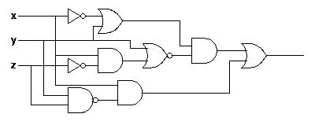
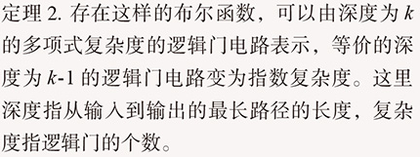
Why Deep? Analogy
Logic circuits
Neural network
Logic circuits consists of gates
A two layers of logic gates can represent any Boolean function.
Using multiple layers of logic gates to build some functions are much simpler
Neural network consists of neurons
A hidden layer network can represent any continuous function.
Using multiple layers of neurons to represent some functions are much simpler
less parameters
less data?
less gates needed

Slide 17
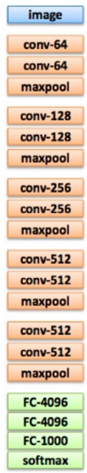
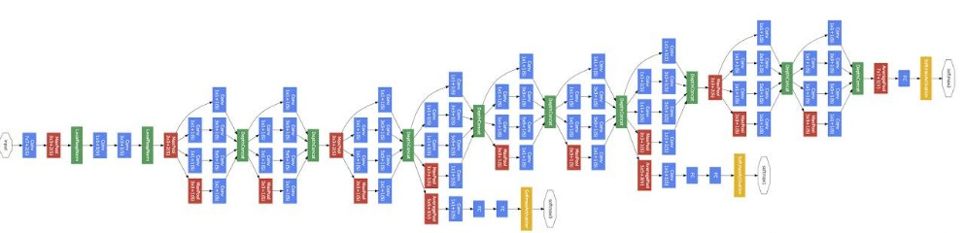
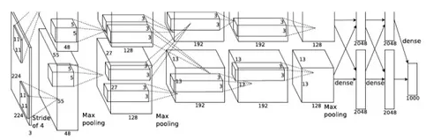
Deep = Many hidden layers
22 layers
http://cs231n.stanford.edu/slides/winter1516_lecture8.pdf
19 layers
8 layers
6.7%
7.3%
16.4%
AlexNet (2012)
VGG (2014)
GoogleNet (2014)

Slide 18
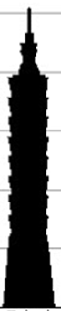
Deep = Many hidden layers
101 layers
152 layers
3.57%
7.3%
6.7%
16.4%
AlexNet (2012)
VGG
(2014)
GoogleNet
(2014)
Residual Net
(2015)
Taipei
101
Notes:
，曾於2004年12月31日至2010年1月4日間擁有世界第一高樓的紀錄

Slide 19
Output Layer
Softmax layer as the output layer
Ordinary Layer
In general, the output of network can be any value.
May not be easy to interpret
Notes:
Original output layer is local

Slide 20
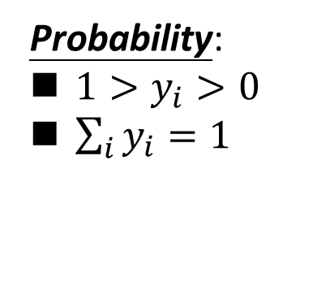
Output Layer
Probability:
$1>y_{i}>0$
$\sum_{i}{y_{i}=1}$
Softmax layer as the output layer
Softmax Layer
3
20
0.88
1
2.7
0.12
-3
0.05
≈0
Notes:
Why it is name soft max?
Monotonicity of softmax
Non-locality of softmax

Slide 21
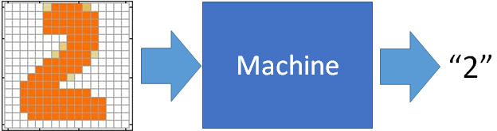
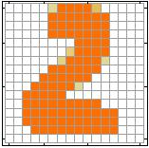
Example Application
Input
Output
y₁
is 1
0.1
y₂
is 2
0.7
The image is “2”
……
……
……
y₁₀
0.2
is 0
16 x 16 = 256
Ink → 1
No ink → 0
Each dimension represents the confidence of a digit.
Notes:
The same for even more complex tasks.

Slide 22
Example Application
Handwriting Digit Recognition
y₁
is 1
Machine
y₂
is 2
Neural
Network
“2”
……
……
……
y₁₀
is 0
What is needed is a function ……
Input:
256-dim vector
output:
10-dim vector
Notes:
The same approach for other cases

Slide 23
Example Application
Input
Layer 1
Layer 2
Layer L
Output
……
y₁
is 1
……
A function set containing the candidates for
Handwriting Digit Recognition
y₂
is 2
“2”
……
……
……
……
……
……
……
y₁₀
is 0
Input Layer
Output Layer
Hidden Layers
You need to decide the network structure to let a good function in your function set.

Slide 24
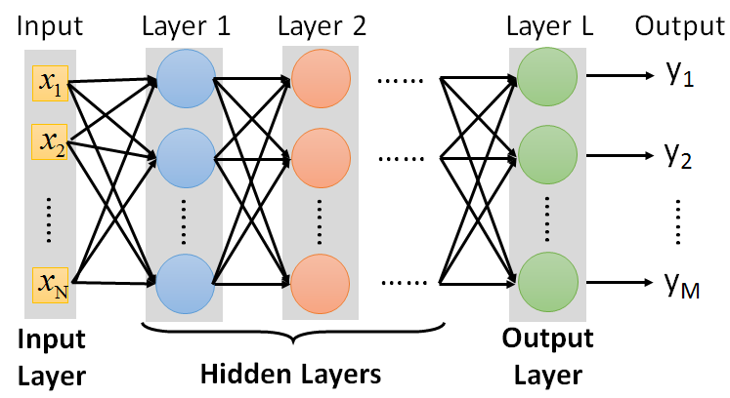
FAQ
Q: How many layers? How many neurons for each layer?
Q: Can we design the network structure?
Q: Can the structure be automatically determined?
Yes, but not widely studied yet.
Trial and Error
+
Intuition
CNN, RNN, BiLSTM, Transformer…..

Slide 25
Three Steps for Deep Learning
Step 1: define a set of function
Step 2: goodness of function
Step 3: pick the best function

Slide 26


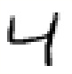





Training Data
Preparing training data: images and their labels
“5”
“0”
“4”
“1”
“9”
“2”
“1”
“3”
The learning target is defined on the training data.
Notes:
(學習教材)

Slide 27


Learning Target
……
y₁
is 1
……
y₂
Softmax
is 2
……
……
……
……
y₁₀
is 0
16 x 16 = 256
Ink → 1
No ink → 0
The learning target is ……
Input:
y₁ has the maximum value
Input:
y₂ has the maximum value

Slide 28

Loss
A good function should make the loss of all examples as small as possible.
“1”
……
y₁
1
As close as possible
……
y₂
Given a set of parameters
0
Softmax
……
……
……
……
……
Loss
$$l$$
……
y₁₀
0
Loss can be square error or cross entropy between the network output and target
target
Notes:
With softmax, the summation of all the ouputs would be one.
Can be considered as probability if you want ……

Slide 29
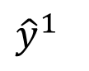
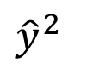
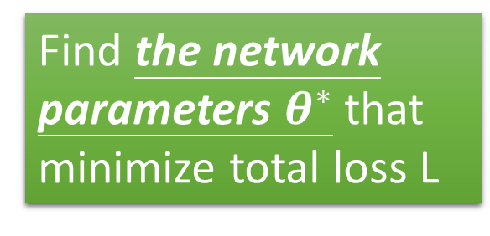
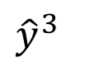
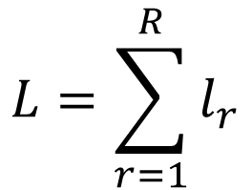
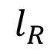
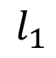
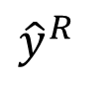
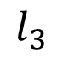
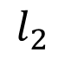
Total Loss
Total Loss:
$$L=\sum_{r=1}^{R}{l_{r}}$$
For all training data …
x¹
NN
y¹
$${\hat{y}}^{1}$$
$$l_{1}$$
As small as possible
x²
NN
y²
$${\hat{y}}^{2}$$
Find a function in function set that minimizes total loss L
$$l_{2}$$
x³
NN
y³
$${\hat{y}}^{3}$$
$$l_{3}$$
……
……
……
……
Find the network parameters $θ^{∗}$ that minimize total loss L
x^{R}
NN
y^{R}
$${\hat{y}}^{R}$$
$$l_{R}$$
Notes:
Randomly picked one
Two approaches update the parameters towards the same direction, but stochastic is faster!
Better!

Slide 30
Three Steps for Deep Learning
Step 1: define a set of function
Step 2: goodness of function
Step 3: pick the best function

Slide 31


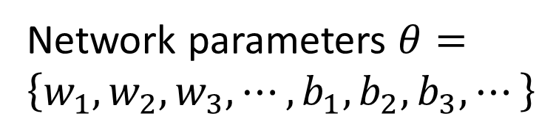
How to pick the best function
Find network parameters $θ^{∗}$ that minimize total loss L
Layer l
Layer l+1
Enumerate all possible values
Network parameters $θ=\left\{w_{1},w_{2},w_{3},⋯,b_{1},b_{2},b_{3},⋯\right\}$
10⁶
weights
……
……
Millions of parameters
E.g. speech recognition: 8 layers and 1000 neurons each layer
1000
neurons
1000
neurons
Notes:
百萬等級的
Solving this optimization problem by Calculus or something

Slide 32

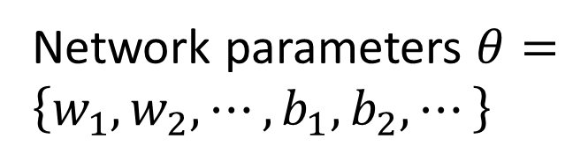
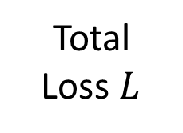
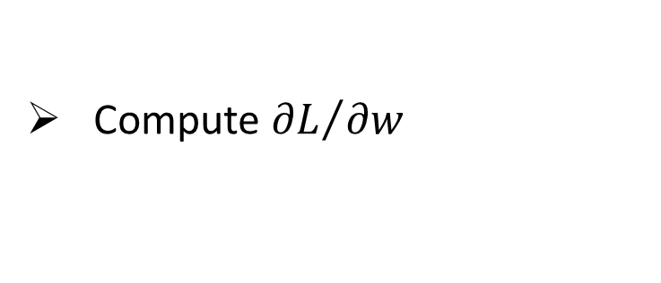
Gradient Descent
Network parameters $θ=\left\{w_{1},w_{2},⋯,b_{1},b_{2},⋯\right\}$
Find network parameters $θ^{∗}$ that minimize total loss L
Pick an initial value for w
Total
Loss $L$
Compute ${∂L}/{∂w}$
Negative
Increase w
Positive
Decrease w
http://chico386.pixnet.net/album/photo/171572850
Notes:
Consider a parameter w in $θ$
切線斜率

Slide 33
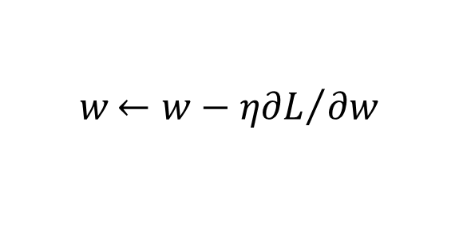
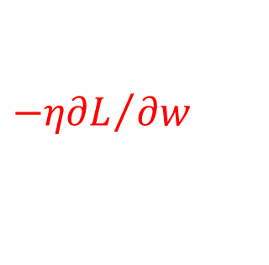
Gradient Descent
Network parameters $θ=\left\{w_{1},w_{2},⋯,b_{1},b_{2},⋯\right\}$
Find network parameters $θ^{∗}$ that minimize total loss L
Pick an initial value for w
Total
Loss $L$
Compute ${∂L}/{∂w}$
$$w{←w−η∂L}/{∂w}$$
Repeat
η is called “learning rate”
$${−η∂L}/{∂w}$$
Notes:
eta
Consider a parameter w in $θ$

Slide 34
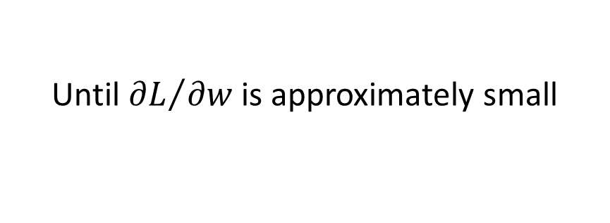
Gradient Descent
Network parameters $θ=\left\{w_{1},w_{2},⋯,b_{1},b_{2},⋯\right\}$
Find network parameters $θ^{∗}$ that minimize total loss L
Pick an initial value for w
Total
Loss $L$
Compute ${∂L}/{∂w}$
$$w{←w−η∂L}/{∂w}$$
Repeat
Until ${∂L}/{∂w}$ is approximately small
(when update is little)
Notes:
Consider a parameter w in $θ$

Slide 35
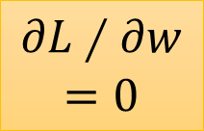

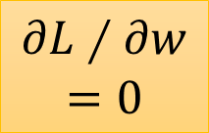
Local Minima
Total
Loss
Very slow at the plateau
Stuck at saddle point
Stuck at local minima
$$∂L∕∂w$$
$$≈0$$
$$∂L∕∂w$$
$$=0$$
$$∂L∕∂w$$
$$=0$$
The value of a network parameter w

Slide 36
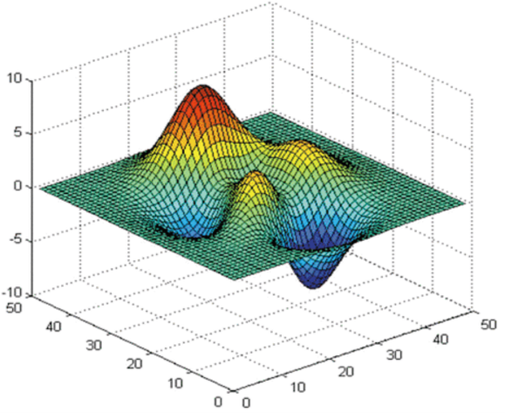
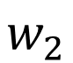
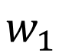
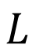
Local Minima
Gradient descent never guarantee global minima
Different initial point
$$L$$
Reach different minima, so different results
$$w_{1}$$
$$w_{2}$$
Notes:
看人品的方法
Who is Afraid of Non-Convex Loss Functions?
http://videolectures.net/eml07_lecun_wia/

Slide 37


Gradient Descent
This is the “learning” of machines in deep learning ……
Even alpha go using this approach.
People imagine ……
Actually …..
I hope you are not too disappointed :p

Slide 38






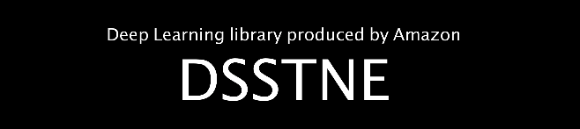

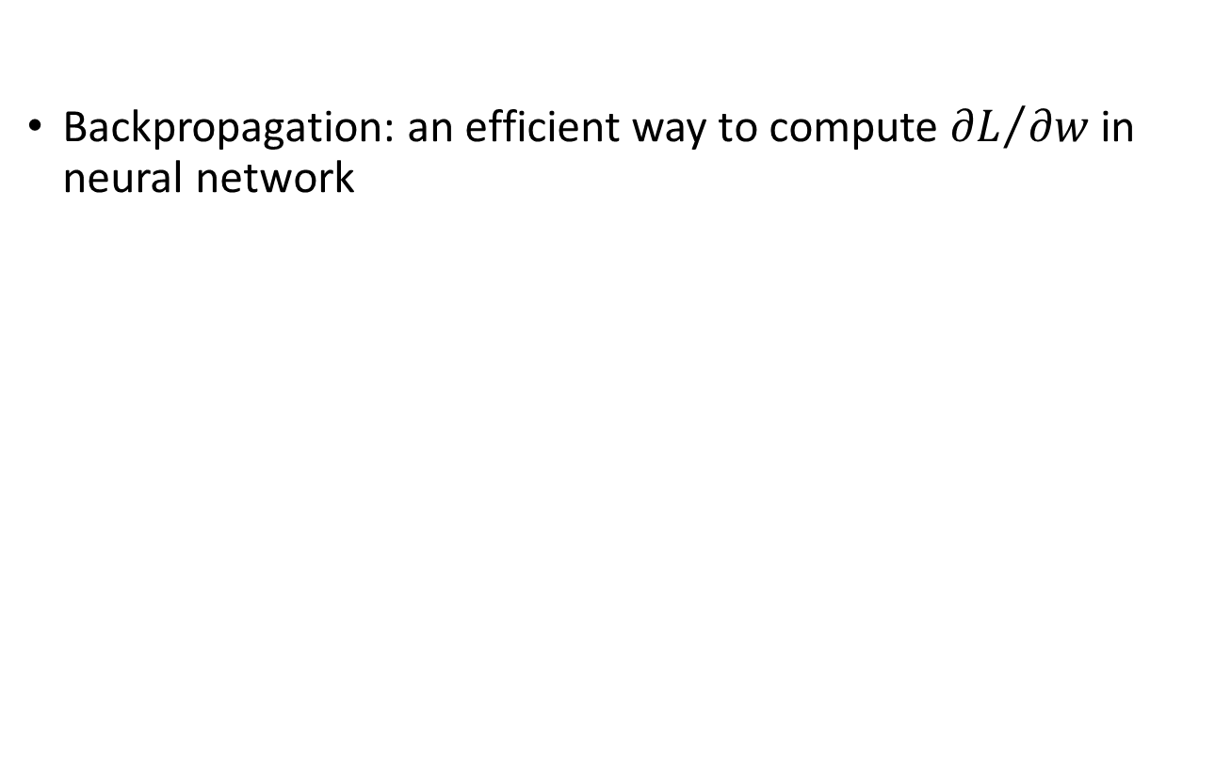
Backpropagation
Backpropagation: an efficient way to compute ${∂L}/{∂w}$ in neural network
libdnn
台大周伯威
同學開發
Ref: https://www.youtube.com/watch?v=ibJpTrp5mcE
Notes:
amazon-dsstne

Slide 39
Three Steps for Deep Learning
Step 1: define a set of function
Step 2: goodness of function
Step 3: pick the best function
Deep Learning is so simple ……
Now If you want to find a function
If you have lots of function input/output (?) as training data
You can use deep learning

Slide 40


For example, you can do …….
Image Recognition
“monkey”
“monkey”
Network
“cat”
“cat”
“dog”
“dog”

Slide 41


For example, you can do …….
“Talk” in e-mail
Spam
filtering
Network
1/0
(Yes/No)
“free” in e-mail
1 (Yes)
0 (No)
(http://spam-filter-review.toptenreviews.com/)
Notes:
Can we have more examples ….

Slide 42
Outline
“Hello World” for Deep Learning
Introduction of Deep Learning
Tips for Deep Learning
Notes:
The three steps can also apply on other machine learning methods

Slide 43

PaddlePaddle: 飞桨
Very flexible
or
Need some effort to learn
Easy to learn and use
Interface of TensorFlow or Theano
(still have some flexibility)
You can modify it if you can write TensorFlow or Theano
keras

Slide 44
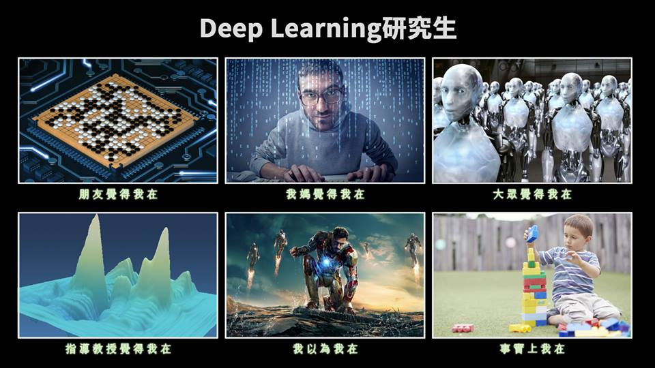
使用 深度学习框架…..

Slide 45
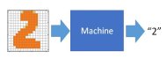

任务介绍
深度学习的“Hello World”——手写数字识别
手写识别属于典型的图像多分类问题
实践平台：百度AI实训平台-AI Studio

Slide 46
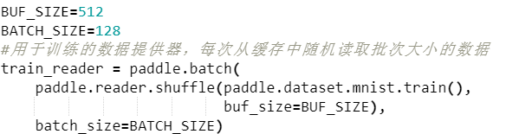
准备数据
训练数据集准备
paddle.dataset.mnist.train()表示获取mnist的训练集
paddle.reader.shuffle()表示每次缓存BUF_SIZE个数据项，并进行打乱
paddle.batch()表示按批次读取乱序后的数据，批次大小为BATCH_SIZE

Slide 47
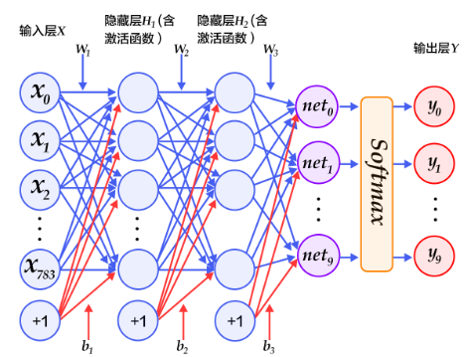

配置网络
定义网络
定义一个三层感知器，感知器的结构是：输入层-->>隐层-->>隐层-->>输出层。
两个大小为100的隐层和一个大小为10的输出层，输出层的激活函数是Softmax。

Slide 48

配置网络
定义数据层
fluid.layers.data():配置数据层
✓张量image:因为是灰度图像，单通道，故形状为[1,28,28],数据类型为float32
✓张量label：代表图像分类后的类别，形状为[1],数据类型为int64
定义损失函数

Slide 49


训练网络
创建优化器
创建训练用Executor
✓ 指定程序运行的设备，fluid.CPUPlace()和 fluid.CUDAPlace(0)分别表示为CPU和GPU
✓ 创建一个Executor实例
✓ Executor接收传入的Program，并通过run()方法运行Program

Slide 50

训练网络
开始训练
对于train_reader中的每次batch,执行exe.run()运行执行器开始训练。
喂入每个batch的训练数据，fetch损失值、准确率。
每100个batch打印一次损失值和准确率。

Slide 51

模型评估
开始测试
对于test_reader中的每次batch,执行exe.run()运行执行器开始测试。
喂入每个batch的训练数据，fetch损失值、准确率。
计算每轮所有batch的误差平均值、误差准确率，然后输出。

Slide 52


模型预测
图片预处理
开始预测
输出结果

Slide 53

Three Steps for Deep Learning
Step 1: define a set of function
Step 2: goodness of function
Step 3: pick the best function
Deep Learning is so simple ……

Slide 54
Outline
“Hello World” for Deep Learning
Introduction of Deep Learning
Tips for Deep Learning
Notes:
The three steps can also apply on other machine learning methods

Slide 55


Recipe of Deep Learning
YES
Step 1: define a set of function
Step 2: goodness of function
Step 3: pick the best function
NO
Good Results on Testing Data?
Overfitting!
YES
NO
Good Results on Training Data?
Neural Network
Notes:
Other methods do not emphasize this.

Slide 56
Recipe of Deep Learning
YES
Momentum
Adaptive Learning Rate
Choosing proper loss
New activation function
Mini-batch
Good Results on Testing Data?
YES
Good Results on Training Data?

Slide 57
Recipe of Deep Learning
YES
Dropout
Early Stopping
Regularization
Network Structure
Good Results on Testing Data?
YES
Good Results on Training Data?

Slide 58
Concluding Remarks
If we can do something before understanding it!

